Slide 1

6th Grade Math
Unit 1, Lesson 7 Whole Numbers Volume 1, pg. 37

Slide 2


Benchmark
MA.5.NSO.2.2
Divide multi-digit whole numbers, up to five digits by two digits, including using a standard algorithm with procedural fluency. Represent remainders as fractions.
volume 1, pg. 37

Slide 3
Integrated Mathematical Thinking and Reasoning Standards
MA.K12.MTR.1.1 Actively participate in effortful learning both individually and collectively.
MA.K12.MTR.2.1 Demonstrate understanding by representing problems in multiple ways.
MA.K12.MTR.4.1 Engage in discussions that reflect on the mathematical thinking of self and others.
volume 1, pg. 37

Slide 4

Learning Target
I can find whole-number quotients of whole numbers.
volume 1, pg. 37

Slide 5

Warm-Up
volume 1, pg. 38

Slide 6
1.7.1 Warm-Up: What Is Math Anxiety?
Have you ever sat down to take a math test and immediately felt your heart beat faster and your palms start to sweat? Sometimes this can happen if you are feeling anxious about math.
What are some of your worries about math class this year?
volume 1, pg. 38

Slide 7
Maryam Mirzakhani is an award-winning mathematician who was born in Iran. After being the first woman to win the prestigious Fields Medal, she stated in an interview, “I did poorly in math for a couple of years in middle school; I was just not interested in thinking about it. I can see that without being excited mathematics can look pointless and cold. The beauty of mathematics only shows itself to more patient followers.”
Remember: the brain is flexible, so your math skills can always grow and develop. Write a positive statement about learning math this year.
volume 1, pg. 38

Slide 8

Guided Instruction
volume 1, pg. 38

Slide 9
1.7.2 Guided Instruction: Division of Whole Numbers
repeated addition.
repeated subtraction.
Division is This is because when
dividing, we are partitioning, or taking out, equal groups
from the whole.
A division expression is shown.
253 ÷ 12
The divisor is the size of the groups that are being partitioned.
In the expression, the divisor is
253.
12.
volume 1, pg. 38

Slide 10
The dividend is the group that is being partitioned.
In the expression, the dividend is
253.
12.
volume 1, pg. 38

Slide 11
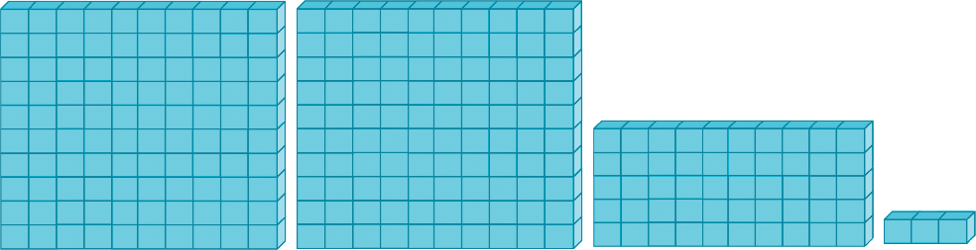
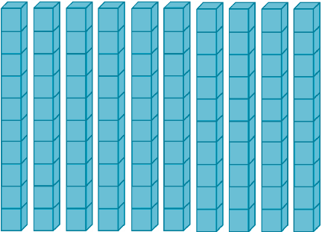
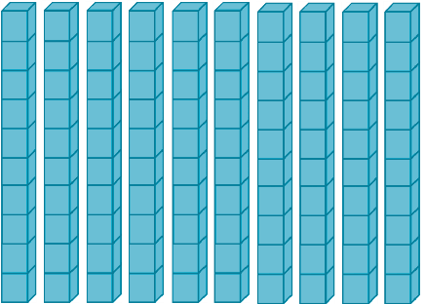
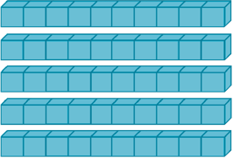

A base-ten model of 253 is shown.
The model should be arranged in 12 equal groups. Since there are not 12 hundreds flats, regroup the hundreds-flats into ten-rods.
volume 1, pg. 39

Slide 12
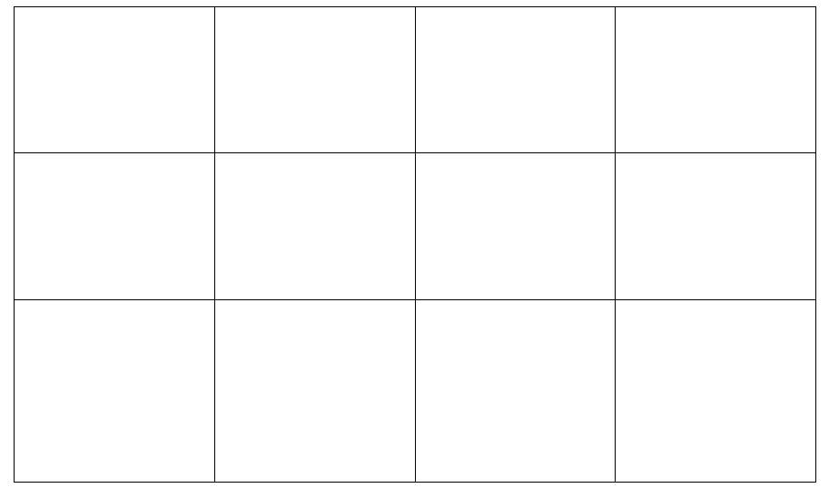

Partition the ten-rods into $12$ equal groups by sketching the ten-rods in the boxes.
How many tens are left after partitioning?
volume 1, pg. 39

Slide 13
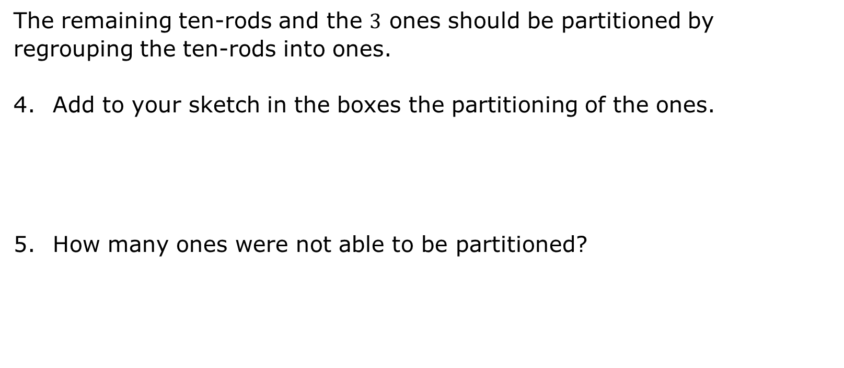
The remaining ten-rods and the $3$ ones should be partitioned by regrouping the ten-rods into ones.
Add to your sketch in the boxes the partitioning of the ones.
How many ones were not able to be partitioned?
volume 1, pg. 39

Slide 14
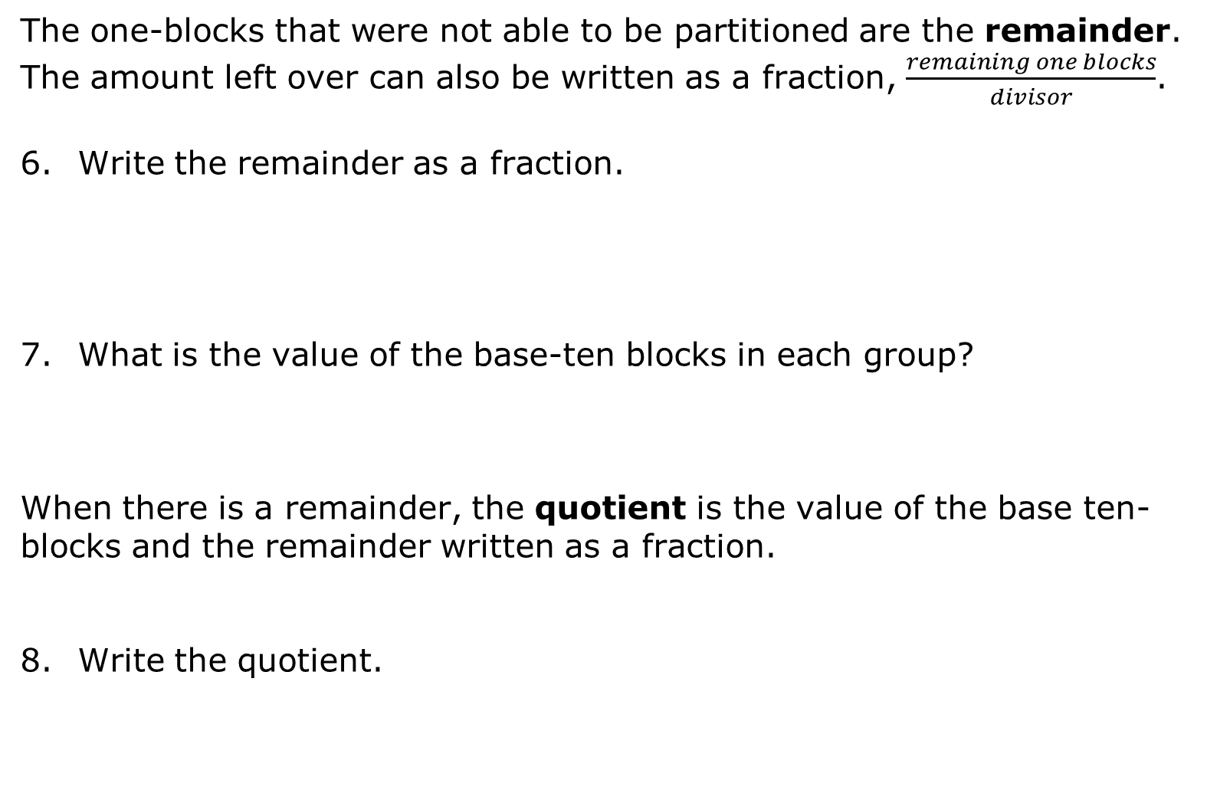
The one-blocks that were not able to be partitioned are the remainder. The amount left over can also be written as a fraction, $\frac{remaining one blocks}{divisor}$.
Write the remainder as a fraction.
What is the value of the base-ten blocks in each group?
When there is a remainder, the quotient is the value of the base ten-blocks and the remainder written as a fraction.
Write the quotient.
volume 1, pg. 40

Slide 15
Complete the equation.
253 ÷ 12 =
volume 1, pg. 40

Slide 16
Guided Instruction
volume 1, pg. 40

Slide 17
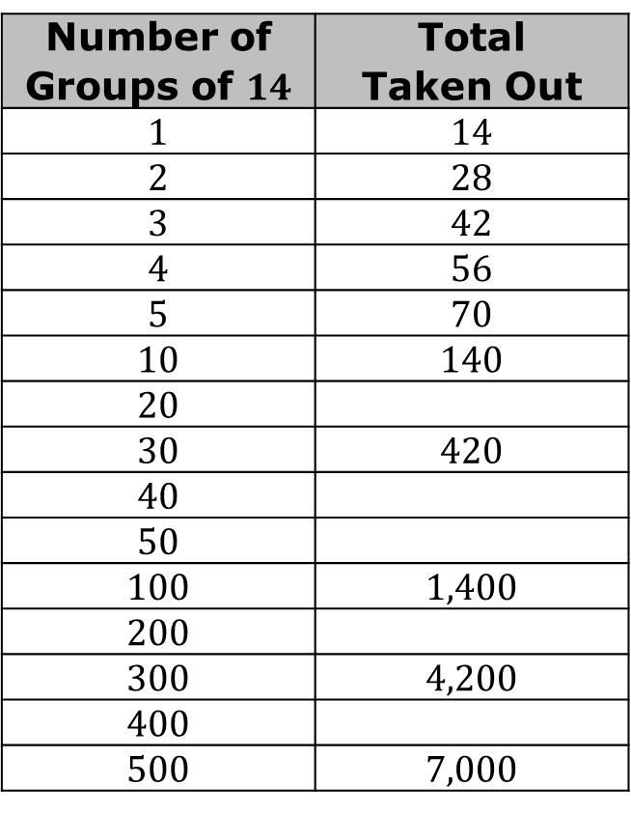
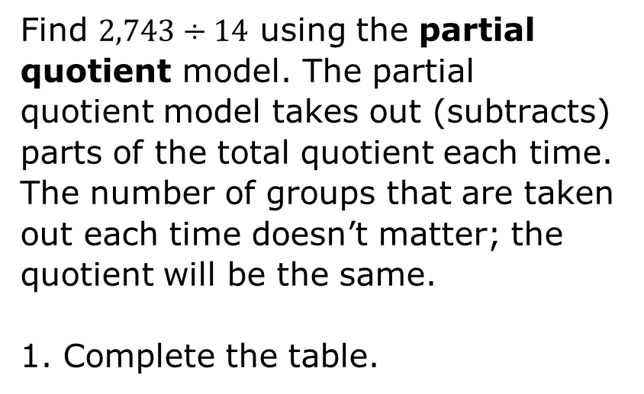
1.7.3 Guided Instruction: Partial Quotient
Find 2,743 $÷$ 14 using the partial quotient model. The partial quotient model takes out (subtracts) parts of the total quotient each time. The number of groups that are taken out each time doesn’t matter; the quotient will be the same.
Complete the table.
Number of Groups of $14$ | Total Taken Out
1 | 14
2 | 28
3 | 42
4 | 56
5 | 70
10 | 140
20
30 | 420
40
50
100 | 1,400
200
300 | 4,200
400
500 | 7,000
volume 1, pg. 40

Slide 18
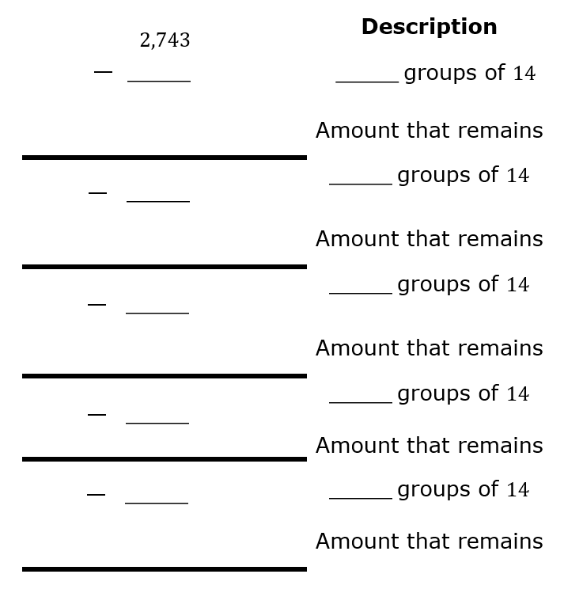
What two numbers in the table is 2,743 between?
Use the smaller number of groups of 14 to begin the repeated subtraction. Add rows if necessary, but do not use rows if there are no remaining groups of 14.
volume 1, pg. 40

Slide 19

How many groups of $14$ were subtracted?
What amount remains?
Write the quotient using the remainder notation and as a mixed number.
volume 1, pg. 41

Slide 20

Try It
volume 1, pg. 41

Slide 21

1.7.4 Try It: Division of Whole Numbers
Type of Group | Number of Groups of 25 | Total Taken Out
ones | 1 | 25
ones | 2 | 50
ones | 3
ones | 4
ones | 5
 | etc.
tens | 10 | 250
tens | 20
tens | 30 | 750
tens | 40
tens | 50
 | etc.
hundreds | 100 | 2,500
hundreds | 200
hundreds | 300 | 7,500
hundreds | 400
hundreds | 500
 | etc.
Complete the table to find 8,988 ÷ 25 using a modified partial quotient model.
volume 1, pg. 41

Slide 22
What two hundreds groups in the table is 8,988 between?
volume 1, pg. 41

Slide 23
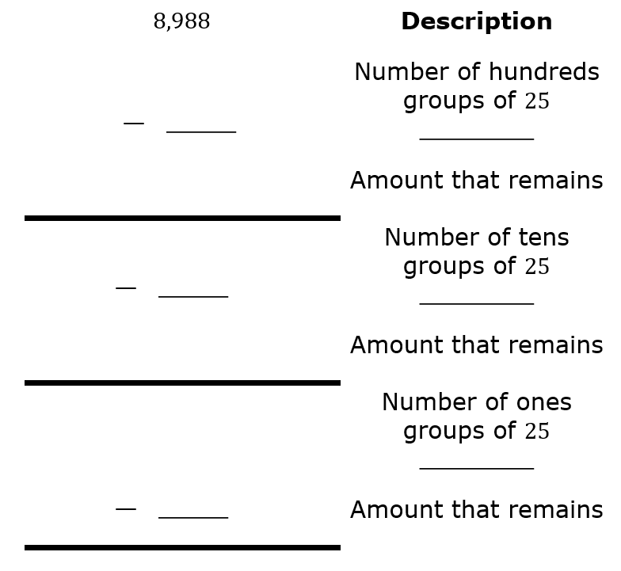
Use the smaller number of hundreds groups of $25$ to begin.
volume 1, pg. 42

Slide 24
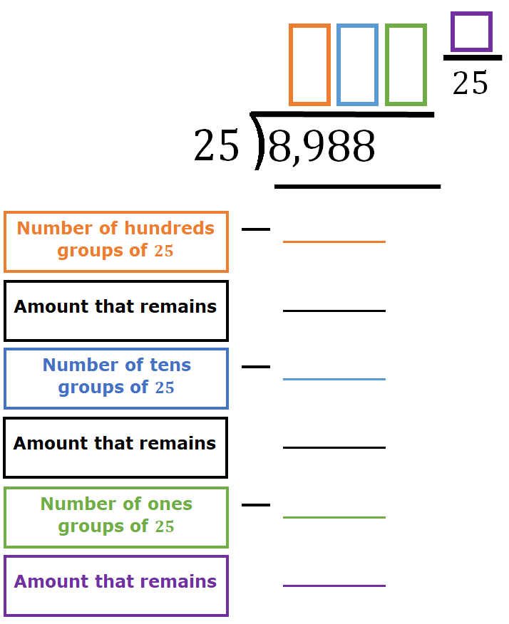
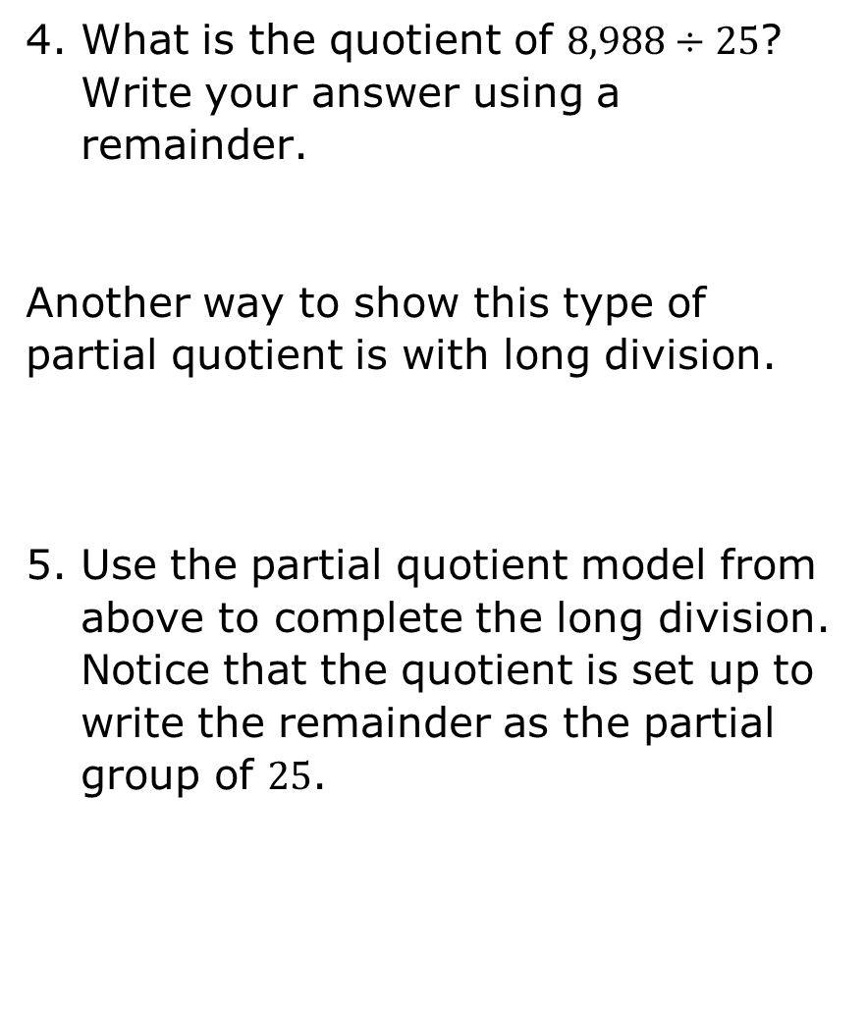
What is the quotient of 8,988 ÷ 25? Write your answer using a remainder.
Another way to show this type of partial quotient is with long division.
Use the partial quotient model from above to complete the long division. Notice that the quotient is set up to write the remainder as the partial group of $25$.
volume 1, pg. 42

Slide 25

Your Turn
volume 1, pg. 43

Slide 26
1.7.5 Your Turn!
Choose a method of division that makes the most sense to you and find each quotient. Show your work and models.
a. 1,276 ÷ 25
b. 7,839 ÷ 92
volume 1, pg. 43

Slide 27
The Publix Warehouse was distributing a shipment of bottled water to 36 Publix grocery stores. There was a total of 18,396 packages to distribute. If each store received an equal amount of bottled water, how many packages did they receive?
volume 1, pg. 43

Slide 28

Wrap-Up
volume 1, pg. 43

Slide 29
1.7.6 Wrap-Up: Growth Mindset
Remember the brain is flexible, so your math skills can always grow and develop. Write a positive statement about what you learned in the lesson.
Complete the statements.
I do not know how to do _____________________ _____________________________________ YET!
I plan to do ______________________________ to help my math skills grow and develop.
volume 1, pg. 43

